Slide 1
Review of linear models
Linear and logistic regression
Terence Parr
MSDS program University of San Francisco

Slide 2
Why do we study linear models?
Simple, interpretable, super fast, can’t be beat for linear relationships
Usually, a lower bound on power but they often form the basis of other more powerful techniques, such as LOESS and…
Combining multiple linear models into a lattice with a nonlinear function as glue yields a neural network; those are insanely useful and powerful
Logistic regression model is a 1-neuron neural network with sigmoid activation
LM can only find separating hyperplane and classes must be contiguous, which is rarely true for more than 1 or 2 vars

Slide 3
Linear regression

Slide 4
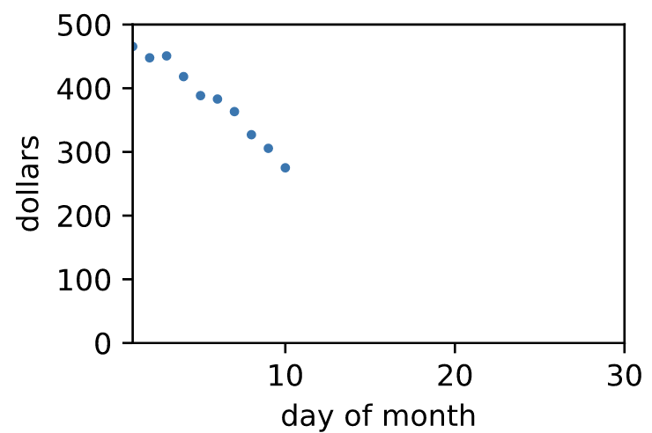
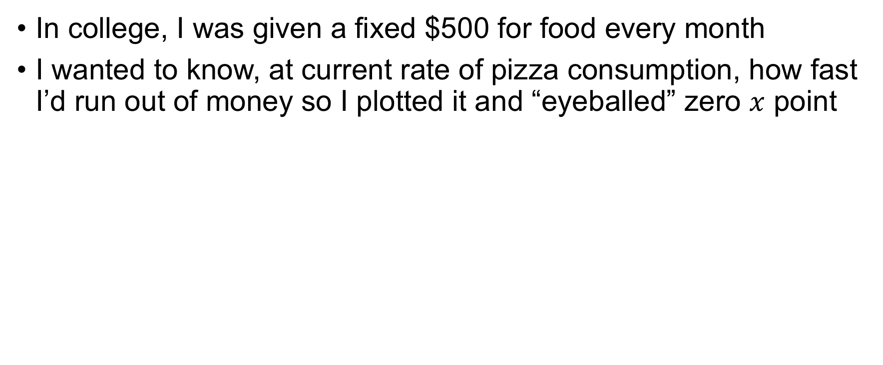
What problem are we solving?
In college, I was given a fixed $500 for food every month
I wanted to know, at current rate of pizza consumption, how fast I’d run out of money so I plotted it and “eyeballed” zero $x$ point
[Car computers that show
number of miles remaining are
solving the same problem]
X
See https://github.com/parrt/msds621/blob/master/notebooks/linear-models/sklearn-linear-models.ipynb

Slide 5
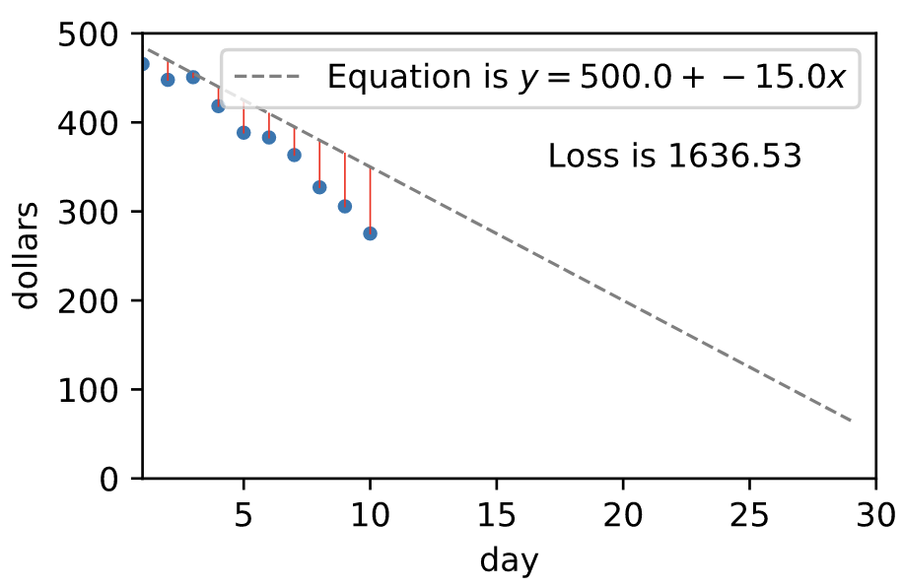
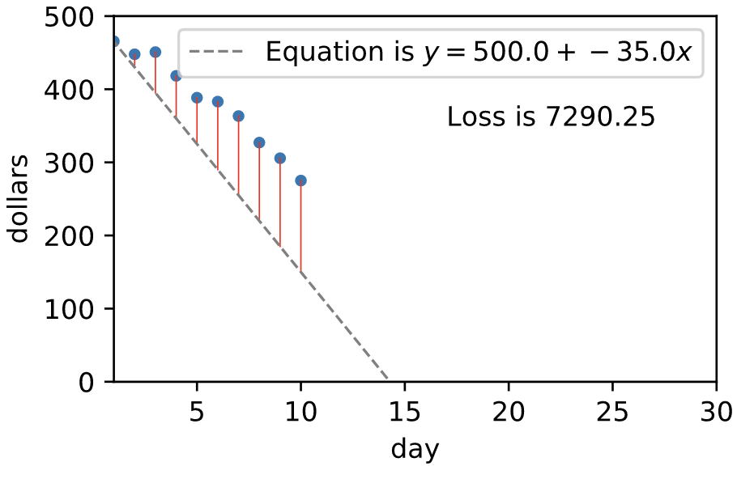
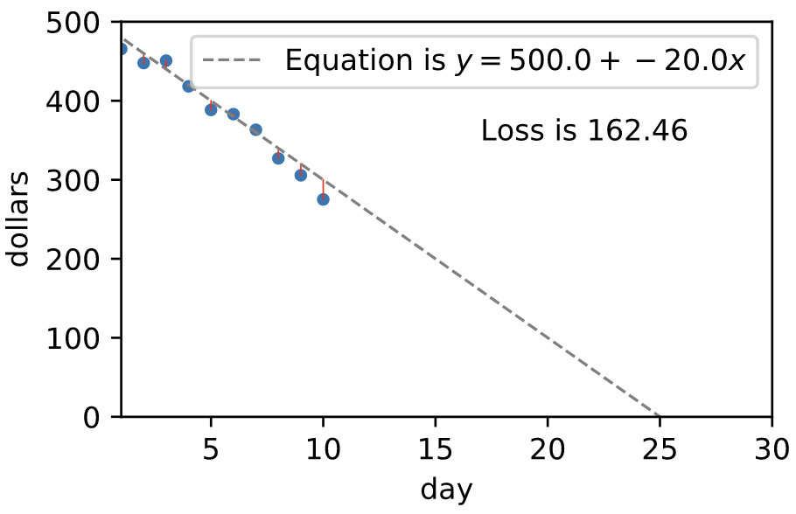
Draw line, manually finding coefficients
I knew to draw line to project into future, but how can we figure out slope of line? (y-intercept is clearly the starting amount)
Measure cost/loss by computing average squared residual error then just move line around until we find min loss (instead of symbolic solution)
bad fit!
bad fit!
good fit!
must
sell
blood
for 5
days!
See https://github.com/parrt/msds621/blob/master/notebooks/linear-models/sklearn-linear-models.ipynb

Slide 6
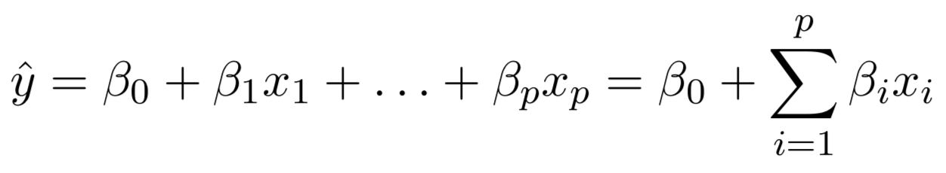
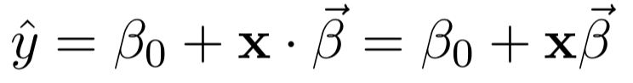
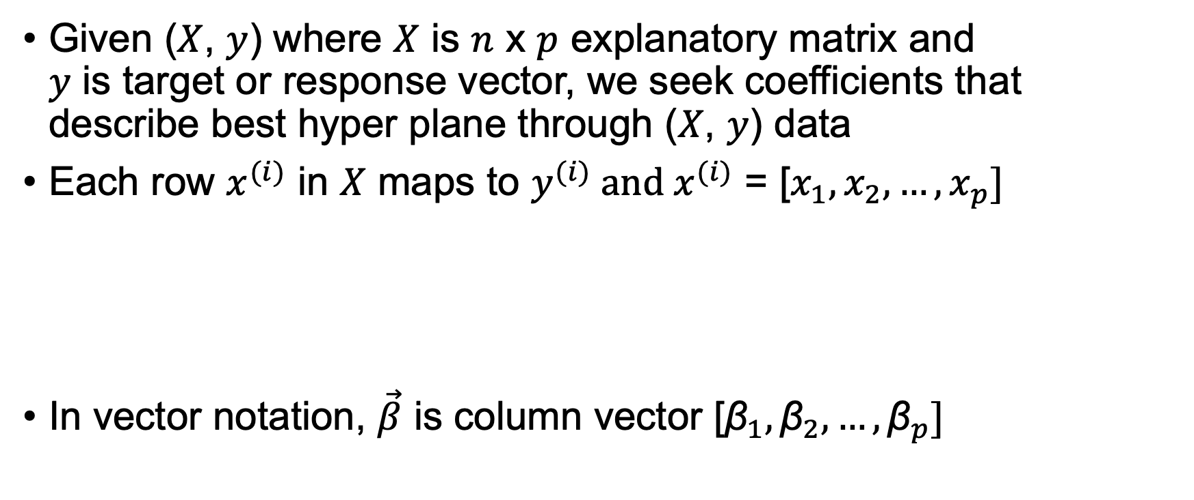
Review of linear regression notation
Given ($X$, $y$) where $X$ is $n$ x $p$ explanatory matrix and $y$ is target or response vector, we seek coefficients that describe best hyper plane through ($X$, $y$) data
Each row $x^{(i)}$ in $X$ maps to $y^{(i)}$ and $x^{(i)}$ = [$x_{1}, x_{2},…, x_{p}]$
In vector notation, $\vec{β}$ is column vector [${\text{β}}_{1}, {\text{β}}_{2},…, {\text{β}}_{p}]$

Slide 7
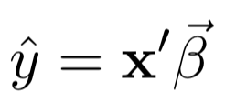
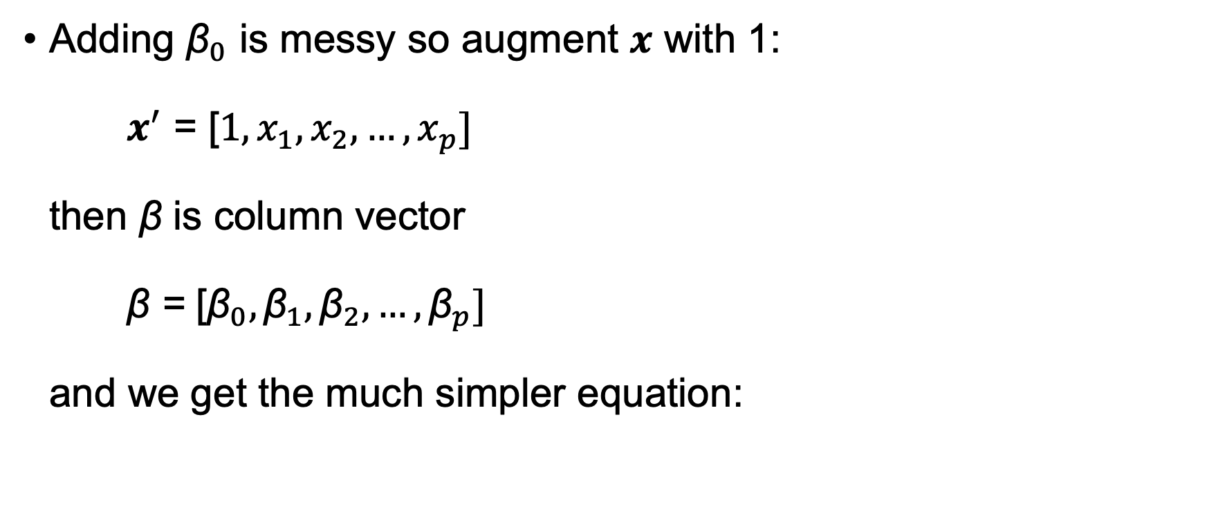
Augment with “1” trick
Adding ${\text{β}}_{0}$ is messy so augment $x$ with 1: $x^{′}$ = [${1,x}_{1}, x_{2},…, x_{p}]$ then β is column vector β = [${\text{β}}_{0},{\text{β}}_{1}, {\text{β}}_{2},…, {\text{β}}_{p}]$ and we get the much simpler equation:

Slide 8
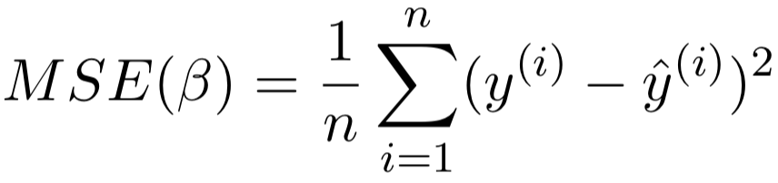
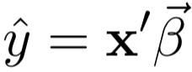
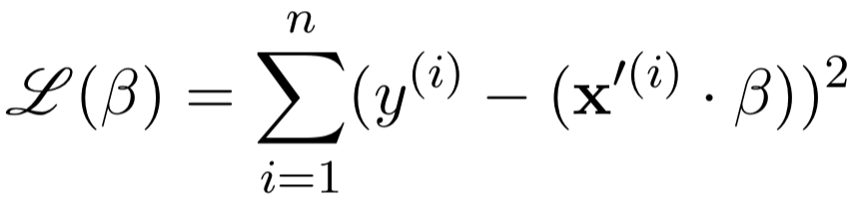
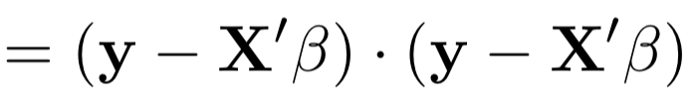
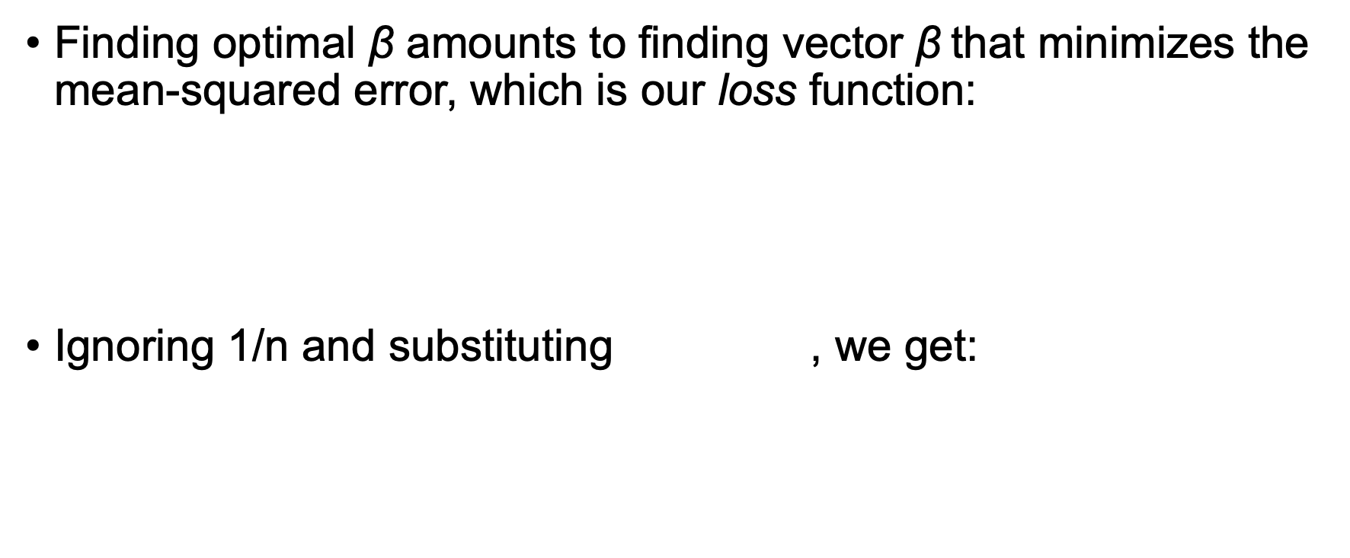
Training/fitting linear model means finding optimal coefficients
Finding optimal $\text{β}$ amounts to finding vector $\text{β}$that minimizes the mean-squared error, which is our loss function:
Ignoring 1/n and substituting , we get:
rows augmented

Slide 9
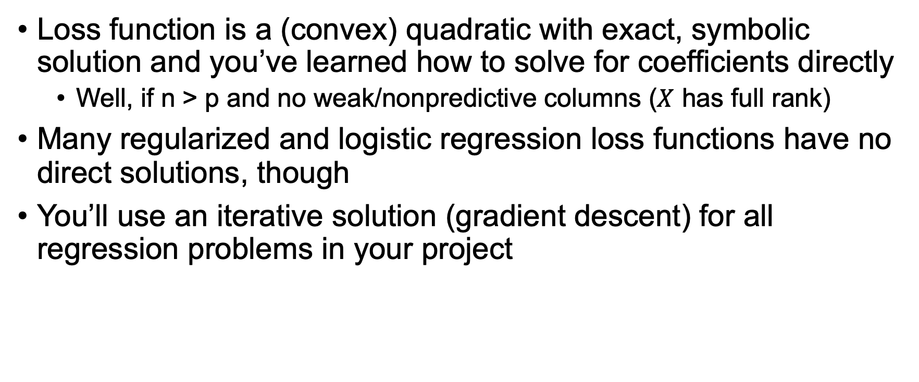

Solutions for finding linear model $\text{β}$
Loss function is a (convex) quadratic with exact, symbolic solution and you’ve learned how to solve for coefficients directly
Well, if n > p and no weak/nonpredictive columns ($X$ has full rank)
Many regularized and logistic regression loss functions have no direct solutions, though
You’ll use an iterative solution (gradient descent) for all regression problems in your project

Slide 10
Training/testing of linear models in Python
Boston dataset example into a notebook: https://github.com/parrt/msds621/blob/master/notebooks/linear-models/sklearn-linear-models.ipynb
boston = load_boston()
X, y = boston.data, boston.target
X_train, X_test, y_train, y_test = \ train_test_split(X, y, test_size=0.2)
lm = LinearRegression() # OLS
lm.fit(X_train, y_train)
s = lm.score(X_test, y_test) # R^2 = 0.66

Slide 11
Logistic regression

Slide 12
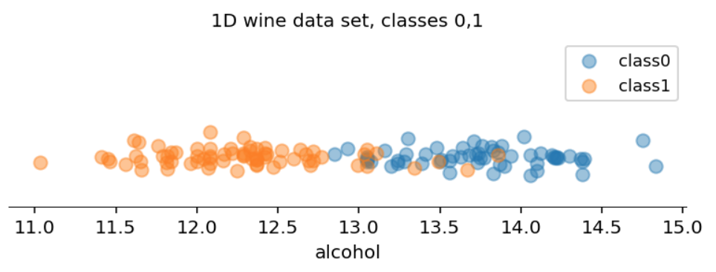
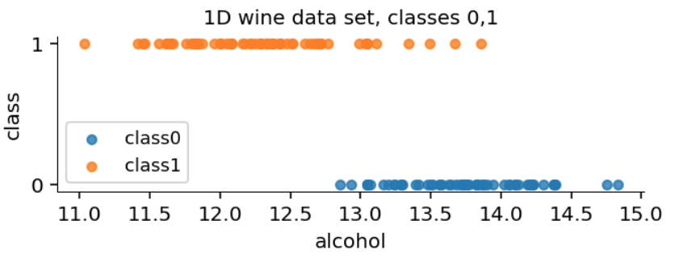
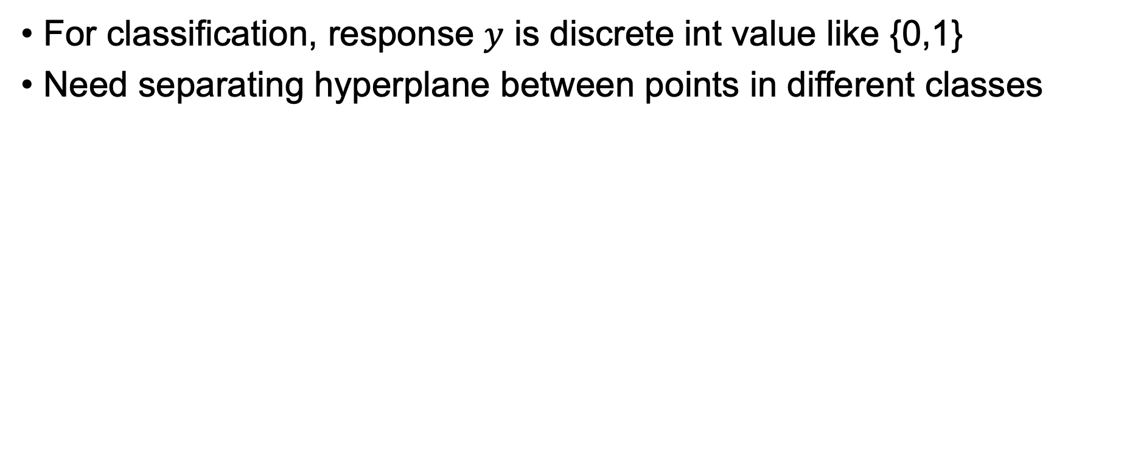
Review of logistic regression
For classification, response $y$ is discrete int value like {0,1}
Need separating hyperplane between points in different classes
Showing hard cutoffs here, but a smooth transition from class 0 to class 1 would be better
See https://github.com/parrt/msds621/blob/master/notebooks/linear-models/sklearn-linear-models.ipynb

Slide 13
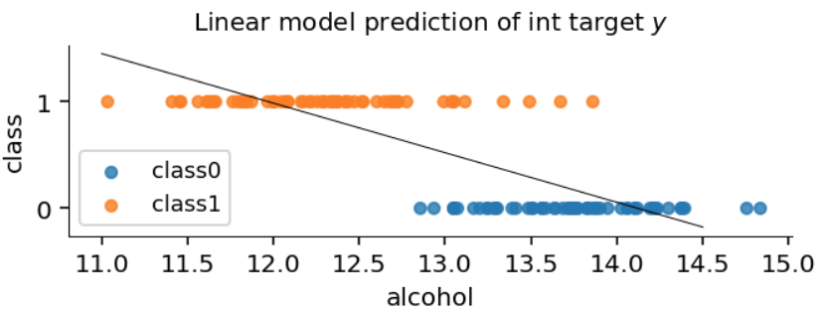
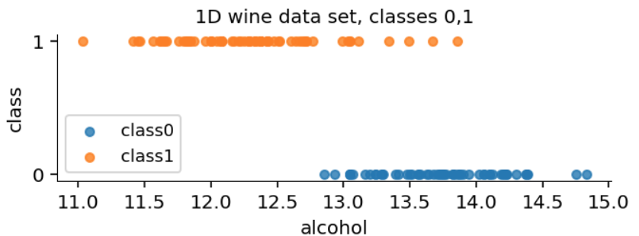
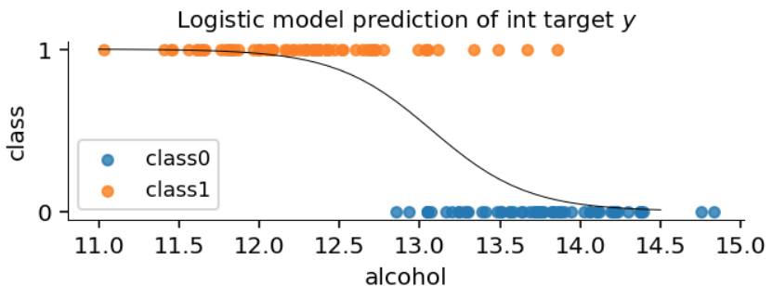
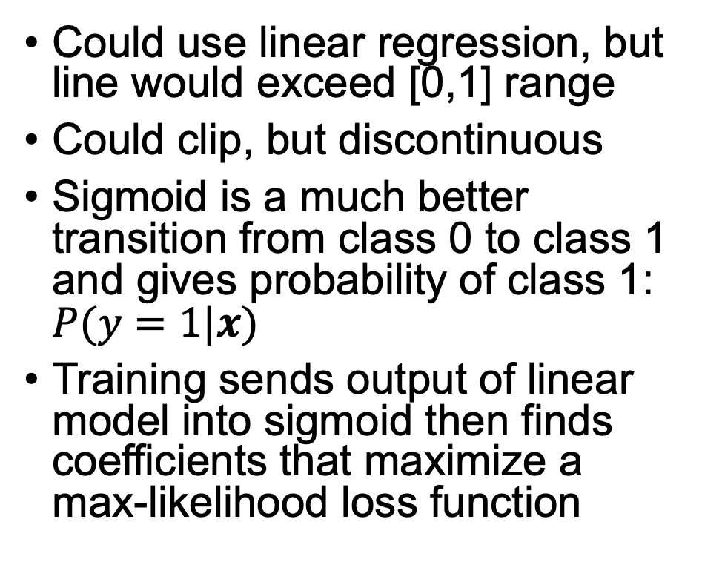
1D logistic regression
Could use linear regression, but line would exceed [0,1] range
Could clip, but discontinuous
Sigmoid is a much better transition from class 0 to class 1 and gives probability of class 1: $P(y=1|x)$
Training sends output of linear model into sigmoid then finds coefficients that maximize a max-likelihood loss function
See https://github.com/parrt/msds621/blob/master/notebooks/linear-models/sklearn-linear-models.ipynb

Slide 14
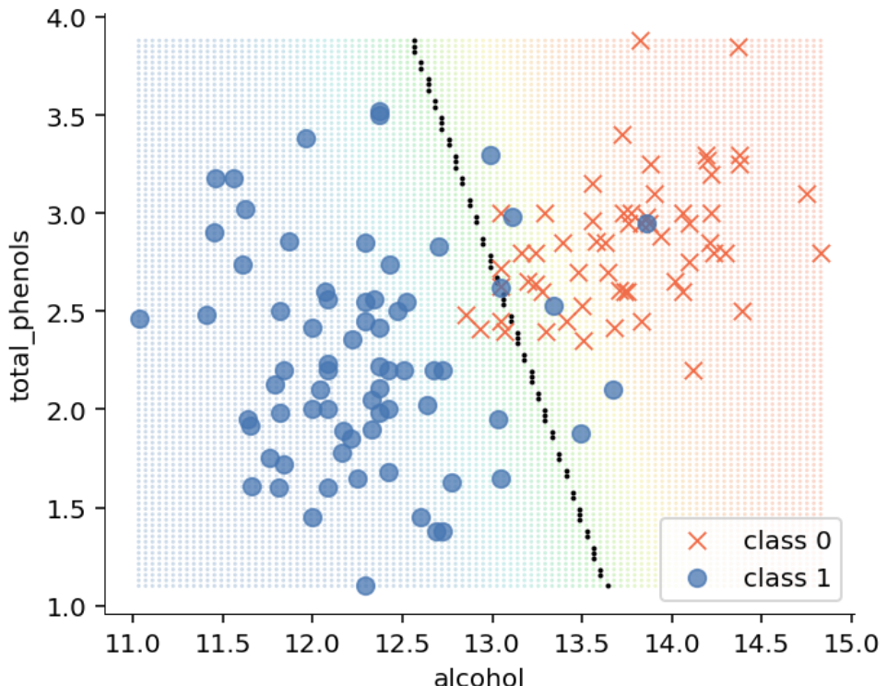
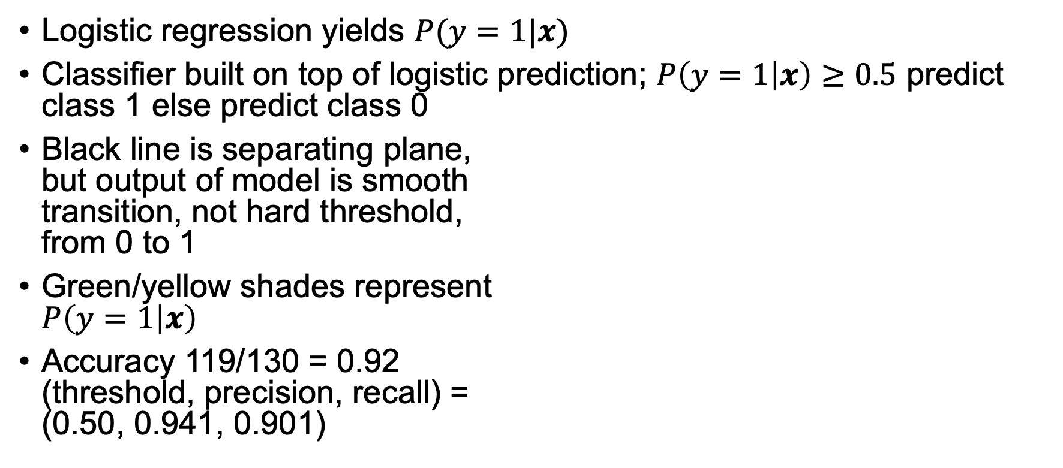
2D wine data set example, 2 features
Logistic regression yields $P(y=1|x)$
Classifier built on top of logistic prediction; $P\left(y=1 | x\right)≥0.5$ predict class 1 else predict class 0
Black line is separating plane, but output of model is smooth transition, not hard threshold, from 0 to 1
Green/yellow shades represent $P\left(y=1 | x\right)$
Accuracy 119/130 = 0.92 (threshold, precision, recall) = (0.50, 0.941, 0.901)
See https://github.com/parrt/msds621/blob/master/notebooks/linear-models/sklearn-linear-models.ipynb

Slide 15
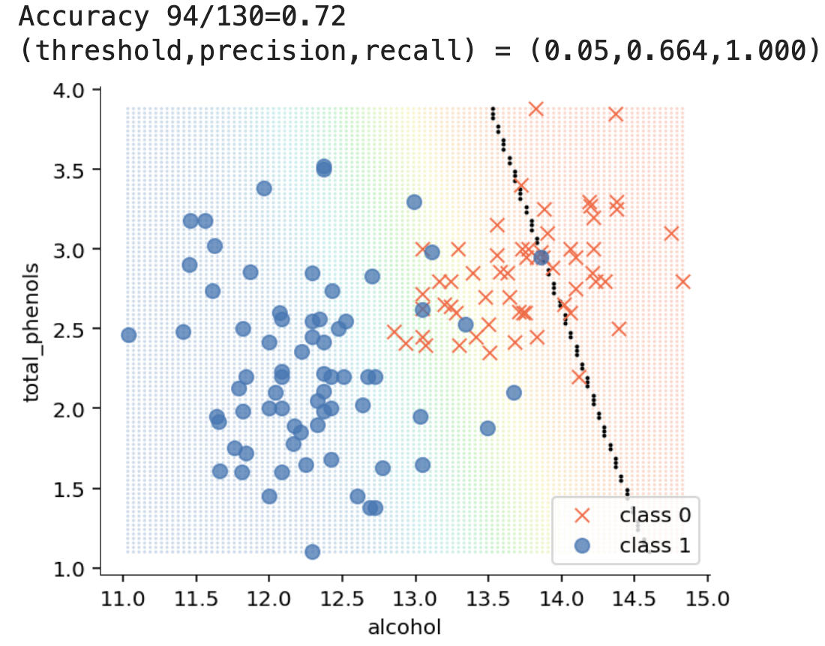
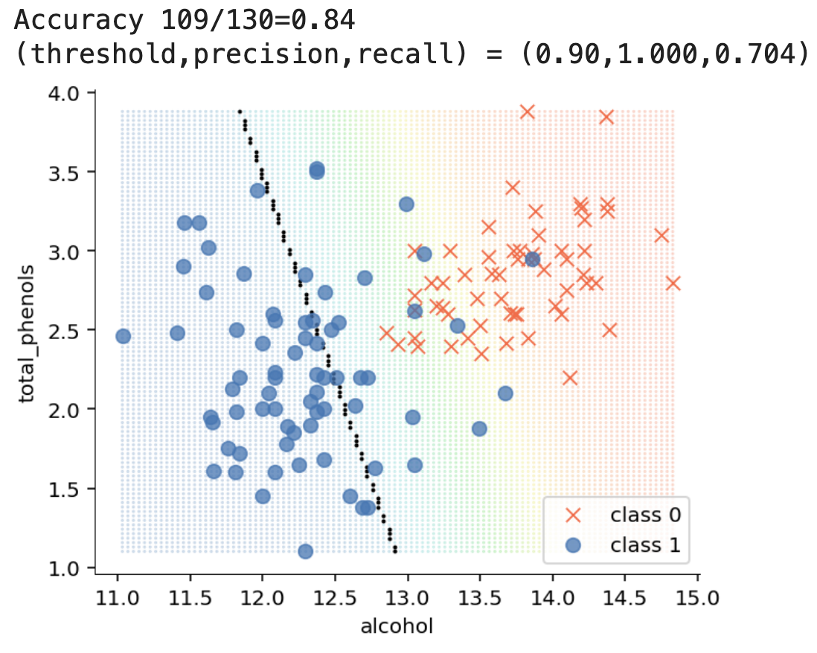

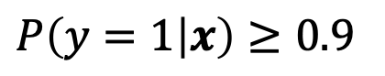
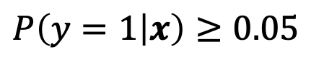
Classifier $P\left(y=1 | x\right)$ threshold changes
$P\left(y=1 | x\right)≥0.05$
$P\left(y=1 | x\right)≥0.9$
Plotting precision and recall for a variety of thresholds yields PR curve (similar to ROC curve)

Slide 16
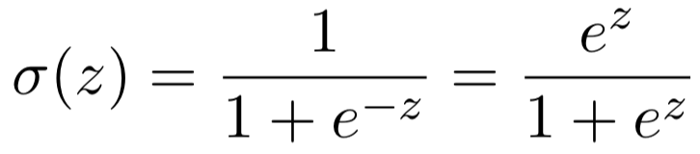
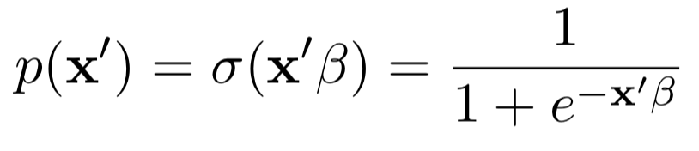
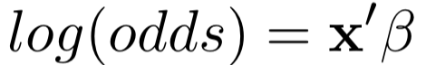
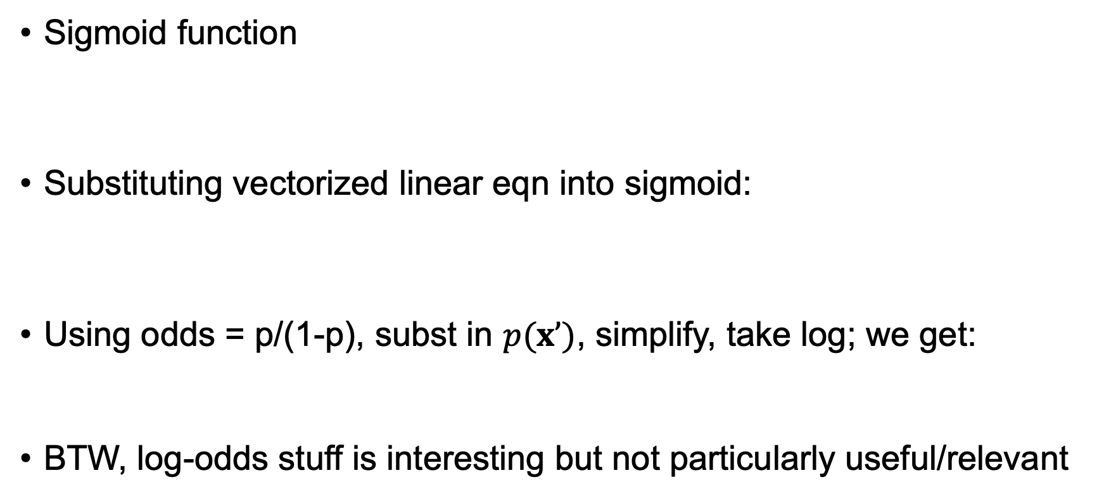
Logistic regression notation
Sigmoid function
Substituting vectorized linear eqn into sigmoid:
Using odds = p/(1-p), subst in $p(x’)$, simplify, take log; we get:
BTW, log-odds stuff is interesting but not particularly useful/relevant
Derivations and intution, see https://github.com/parrt/msds621/raw/master/projects/linreg/linreg.pdf

Slide 17
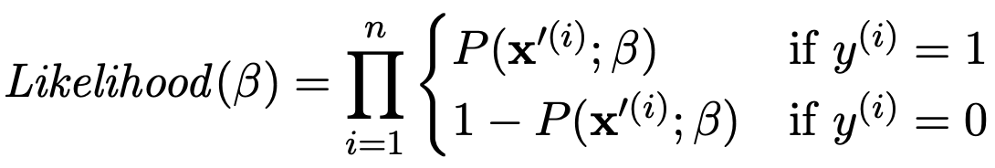
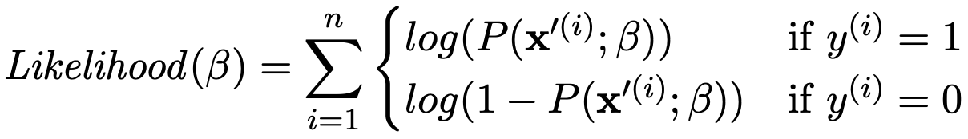
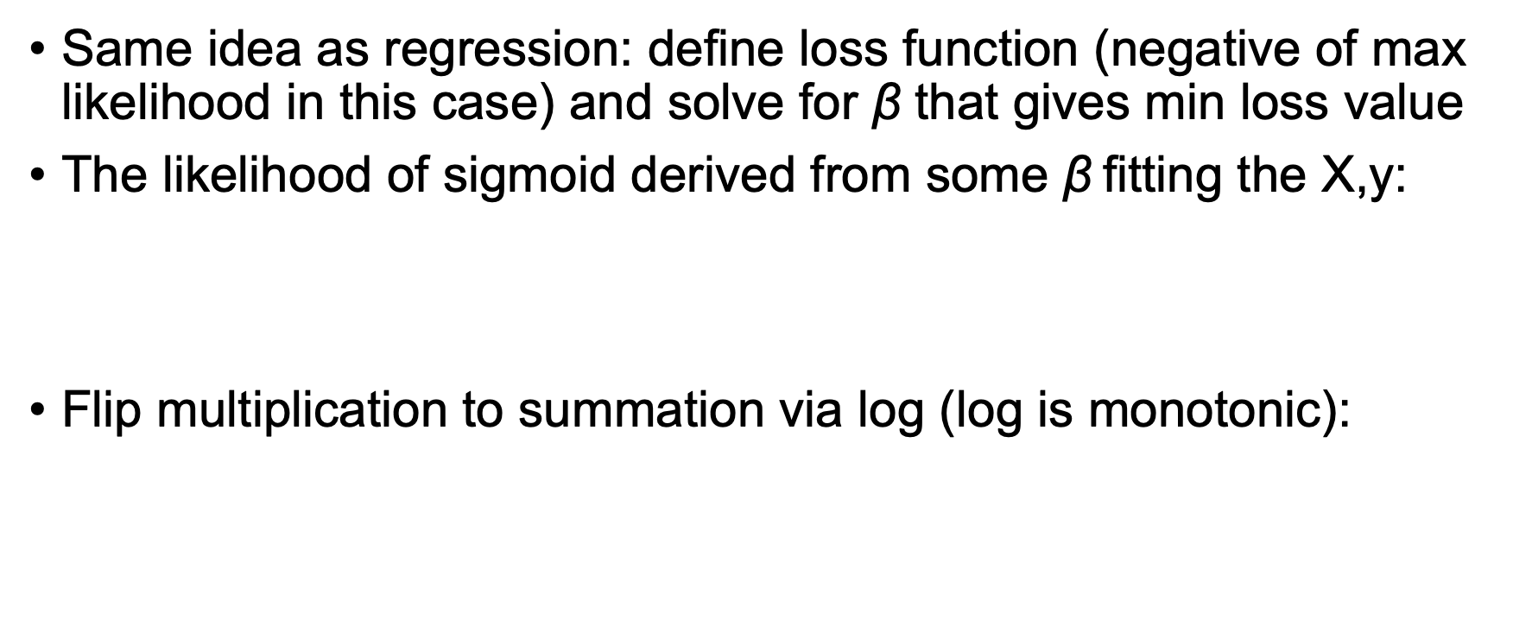
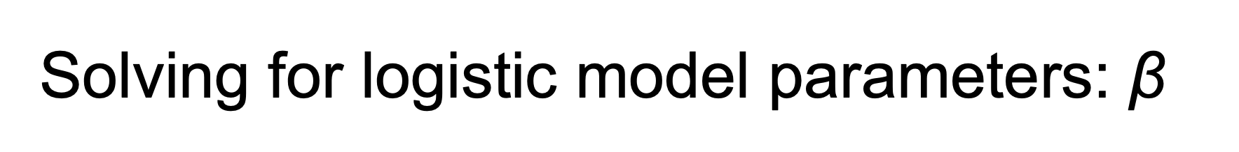
Solving for logistic model parameters: $\text{β}$
Same idea as regression: define loss function (negative of max likelihood in this case) and solve for $\text{β}$ that gives min loss value
The likelihood of sigmoid derived from some $\text{β}$fitting the X,y:
Flip multiplication to summation via log (log is monotonic):
Derivations and intution, see https://github.com/parrt/msds621/raw/master/projects/linreg/linreg.pdf

Slide 18
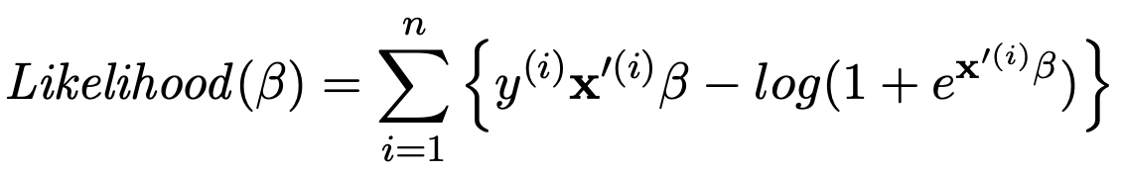
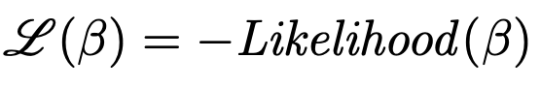
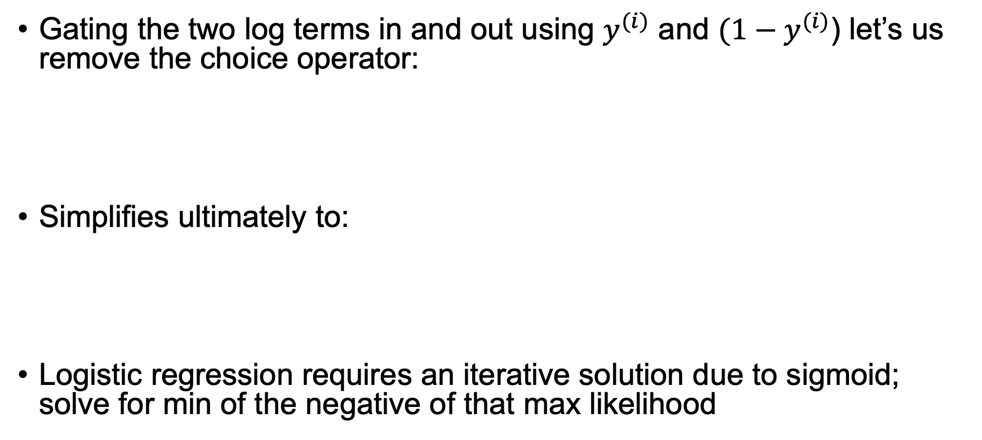
Simplifying max likelihood
Gating the two log terms in and out using $y^{(i)}$ and ${(1−y}^{(i)}$) let’s us remove the choice operator:
Simplifies ultimately to:
Logistic regression requires an iterative solution due to sigmoid; solve for min of the negative of that max likelihood
Derivations and intuition, see https://github.com/parrt/msds621/raw/master/projects/linreg/linreg.pdf

Slide 19
Training/testing of logistic regression models in Python
Wine dataset example from into a notebook: https://github.com/parrt/msds621/blob/master/notebooks/linear-models/classifier-regularization.ipynb
wine = load_wine()
df_wine = pd.DataFrame(data=wine.data,columns=wine.feature_names)
df_wine['y'] = wine.target
df_wine = df_wine[df_wine['y']<2] # do 2-class problem {0,1}
X, y = df_wine.drop('y', axis=1), df_wine['y’]
lg = LogisticRegression(solver='lbfgs', max_iter=1000)
lg.fit(X.values, y) # uses regularization by default
lg.score(X.values, y)

Slide 20
Lab time
Plotting decision surfaces for linear models https://github.com/parrt/msds621/blob/master/labs/linear-models/decision-surfaces.ipynb

